Slide 1

Data Analysis and Graphing in Rstudio
Harlan Seminar, Summer 2019
Emily Kottler

Slide 2
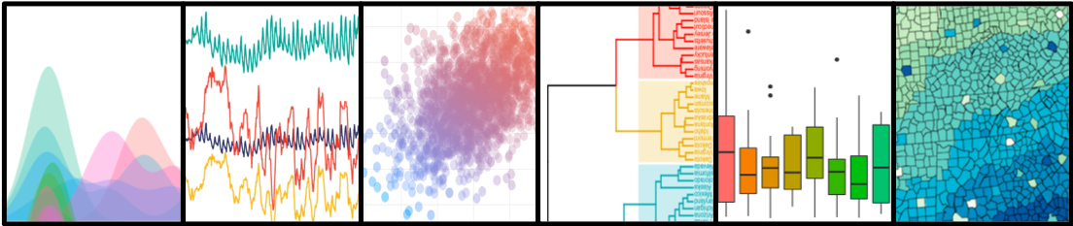
What is R?
It’s both a computer language and a software program for:
organizing data
doing calculations
running statistics
making graphics
…and much more!

Slide 3
What is RStudio?
an “environment” for R:
user-friendly interface organized to view graphs, data tables, R code, and output at the same time
must install R before you can install Rstudio

Slide 4
Why use R?
Its free (unlike many other statistical programs!) and is available for Windows, Macintosh, and Linux.
Open source -> can be freely redistributed and modified
Thousands of free online tutorials from sites like Quick-R and R-documentation
New tools for it are made by the community, you can even make them!
Reproducible Research (self-documenting, repeatable)
once you have the code for making a graph, running a statistic, you have a record of exactly what you did. You repeat that task again and again with different data! So can other researchers if you share it.
Produces publication-quality graphs.
R is becoming the new norm for running biology statistics.

Slide 5
Outline
Rstudio 101
Inputting & Organizing Data
Data Analysis & Graphing
Resources

Slide 6
Terms to know
Script- a text file containing a set of commands and comments
Object- something that stores data. Some common types include: “lists”, “data frames”, and “characters”
Function- a set of commands organized together to perform a specific task (e.g. the function “t.test” runs a t-test)
Package- a collection of R functions, data, and compiled code in a well-defined format. R comes with a standard set of packages and others are available for download and installation

Slide 7
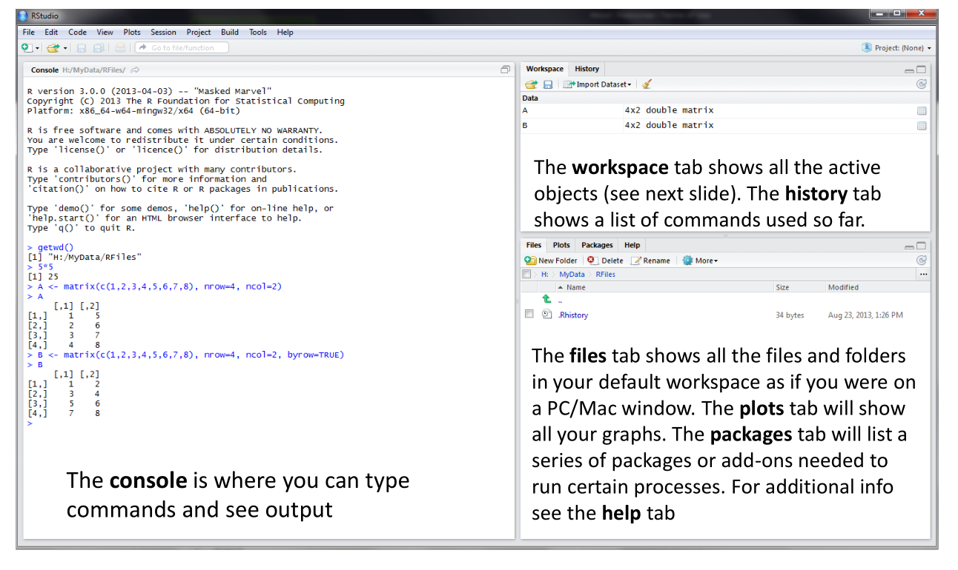
RStudio Screen

Slide 8
Do Exercise 1 in RStudio

Slide 9
Outline
Rstudio 101
Inputting & Organizing Data
Data Analysis & Graphing
Resources

Slide 10
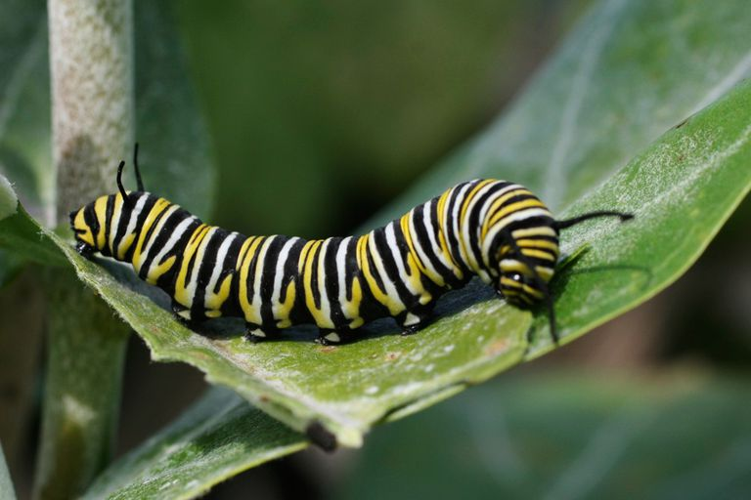
Dataset example
How do habitat characteristics affect caterpillar abundance?

Slide 11
Dataset example
How do habitat characteristics affect caterpillar abundance?
Predictor (independent) variables:
Canopy cover, continous 0-100%
Site “disturbance” (i.e. pollution, trash, mowing and other human influences), categorical
Response (dependent) variable:
# of caterpillars, continuous count data
8 sites
5 plots per site

Slide 12
Tidy Data
“Happy families are all alike; every unhappy family is unhappy in its own way.” –– Leo Tolstoy
“Tidy datasets are all alike, but every messy dataset is messy in its own way.” –– Hadley Wickham

Slide 13
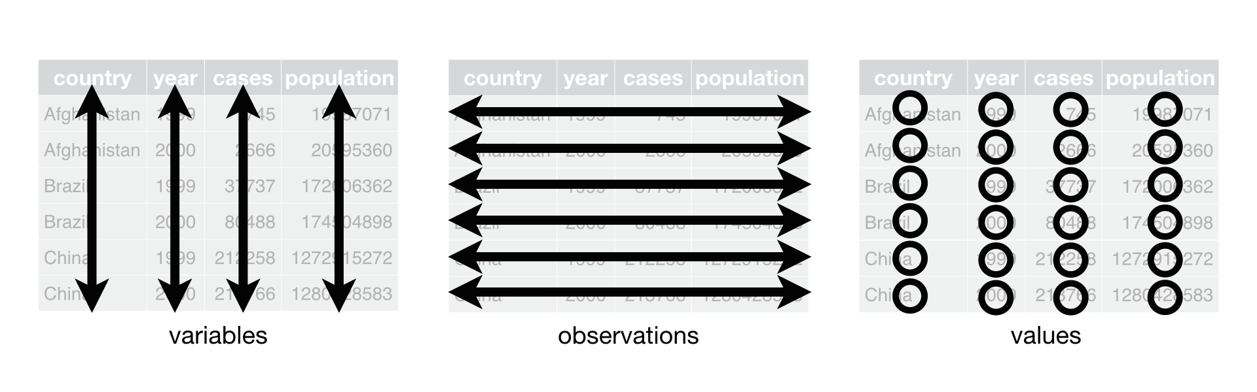
How to format tidy data:
1) Each variable must
have its own column
2) Each observation must have its own row
1) Each value must have its own cell

Slide 14
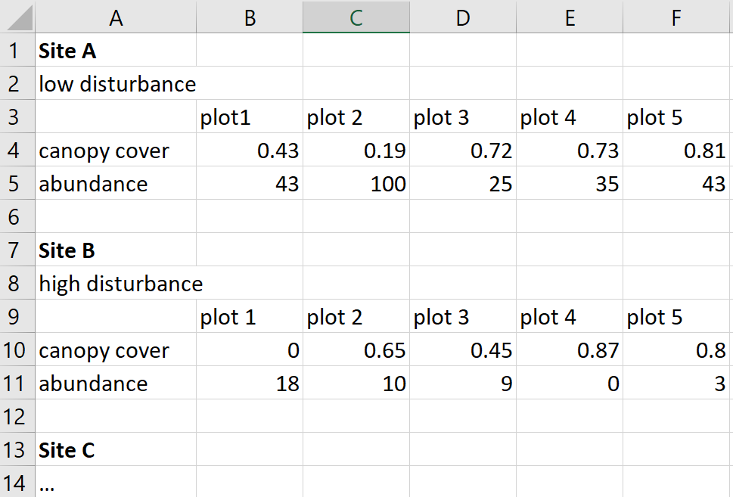
Messy Data Example
How can we make this tidy?

Slide 15
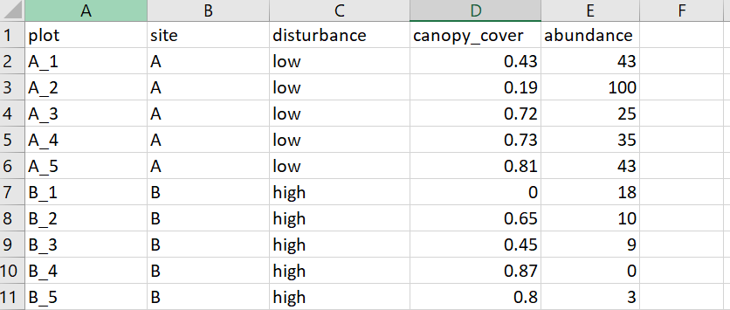
Each variable has its own column
Each observation has its own row
Each value must has its own cell, each cell has a value

Slide 16
Titles lower case, short, no spaces
Each variable has its own column
Each observation has its own row
Each value must has its own cell, each cell has a value
Save file as .csv not .xlsx -> easier for R to deal with

Slide 17
Do Exercise 2 in RStudio

Slide 18
Outline
Rstudio 101
Inputting & Organizing Data
Data Analysis & Graphing
Resources

Slide 19
Steps to working with data in R
Learn about your data with summary statistics & visualization
Run statistical analyses
Graph results

Slide 20
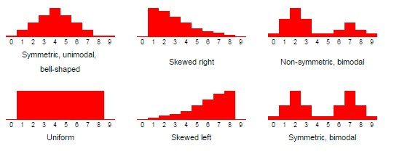
summary statistics
Shape, center and spread of your data
Are there outliers?

Slide 21
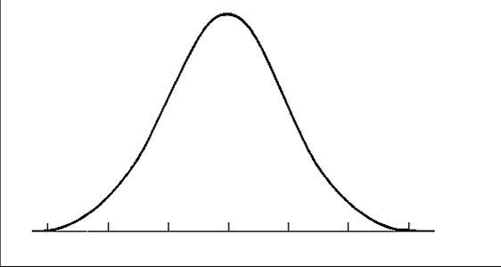
Meeting statistical assumptions
Normality
Shapiro-wilke test

Slide 22
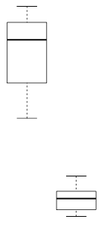
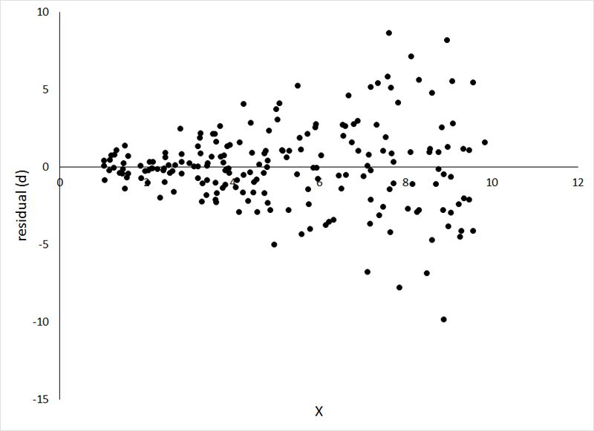
Meeting statistical assumptions
Normality
Shapiro-wilke test
Homogeneity of variance
Levene test

Slide 23
How do we deal with assumption violations?
Transform the data using log or sqrt
Use a model with different assumptions
Generalized linear models can work with different assumed underlying distributions
Non-parametric tests have no assumptions about the underlying distribution, but have less statistical power

Slide 24
Do Exercise 3 in RStudio

Slide 25
Stats time!
We’re going to create a linear model (ANOVA) to test the statistical significance of the relationship between our predictor & response variables

Slide 26
Stats time!
We’re going to create a linear model (ANOVA) to test the statistical significance of the relationship between our predictor & response variables
+
aov( abundance ~ canopy_cover * disturbance)
Dependent
variable
Independent
variables

Slide 27
Do Exercise 4 in RStudio

Slide 28
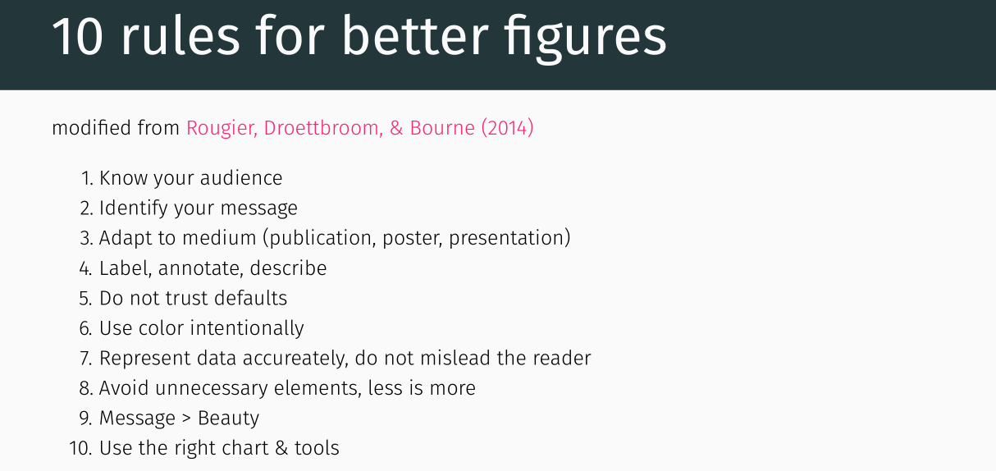

Slide 29
Graphing our results
boxplot()
plot()
Type- what type of plot should be drawn. Possible types are:
"p" for points,
"l" for lines,
"b" for both,
"h" for ‘histogram’

Slide 30
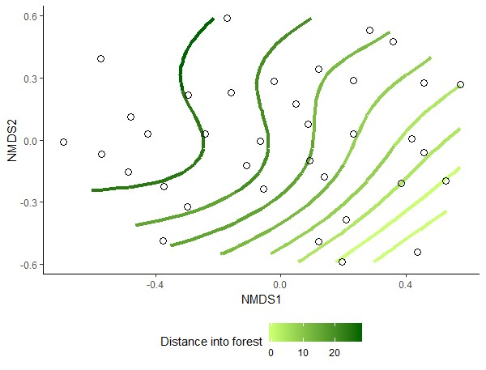
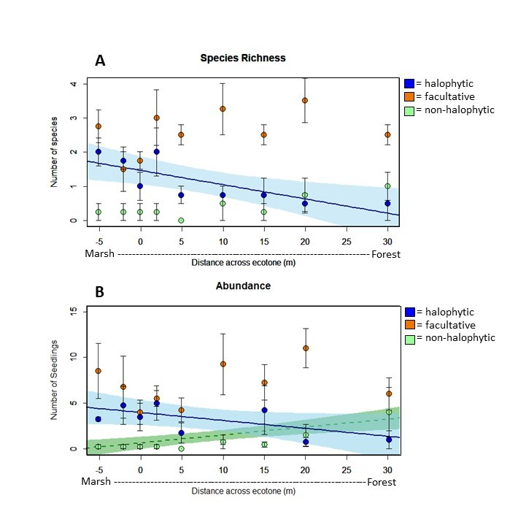
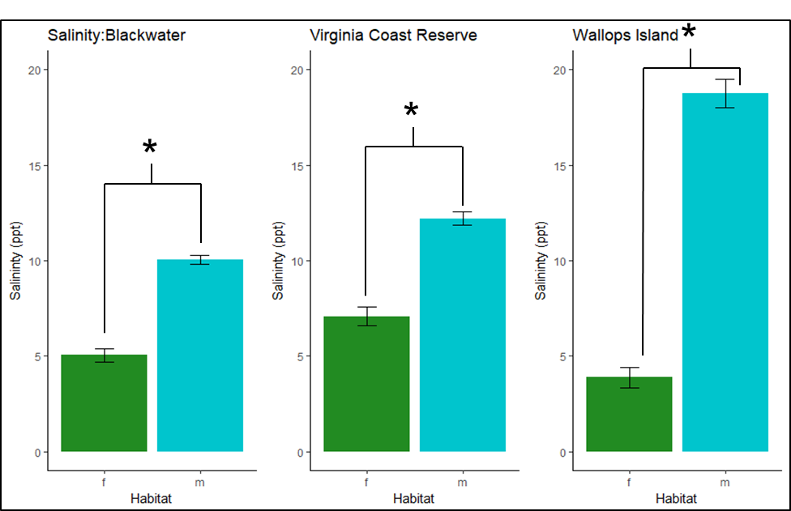

Slide 31
ggplot2: a layered grammar of graphics
1) Assign data
ggplot ( data, aes(x,y) )

Slide 32
ggplot2: a layered grammar of graphics
1) Assign data
2) Aesthetic mappings
maps data to geoms
assign coordinates
color, fill, shape, size, alpha ++
ggplot ( data, aes(x,y) )

Slide 33
ggplot2: a layered grammar of graphics
1) Assign data
2) Aesthetic mappings
maps data to geoms
assign coordinates
color, fill, shape, size, alpha ++
ggplot ( data, aes(x,y) )
+ geoms
3) geometric objects
define what shapes are used to represent data
Points, lines, bars…

Slide 34
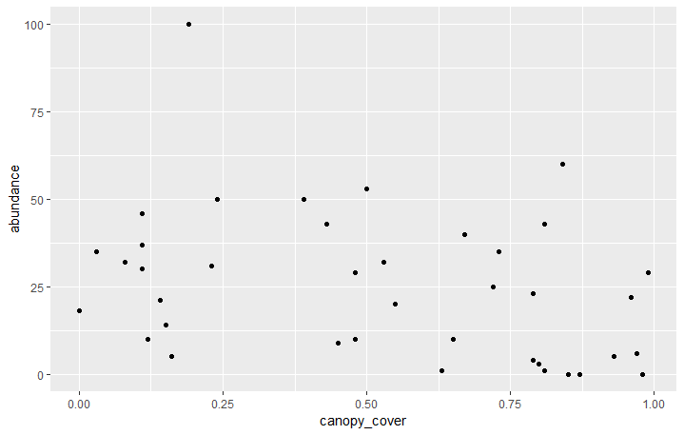
Ex)Scatterplot of abundance vs. cover
ggplot(data, aes(x=canopy_cover,y=abundance)) +
geom_point()

Slide 35
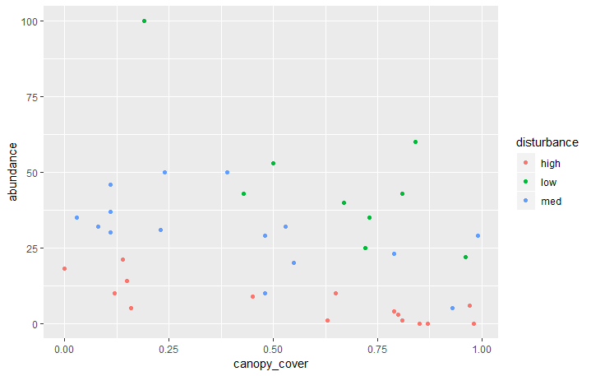
Ex)Scatterplot of abundance vs. cover
ggplot(data, aes(x=canopy_cover,y=abundance, color = disturbance)) +
geom_point()

Slide 36
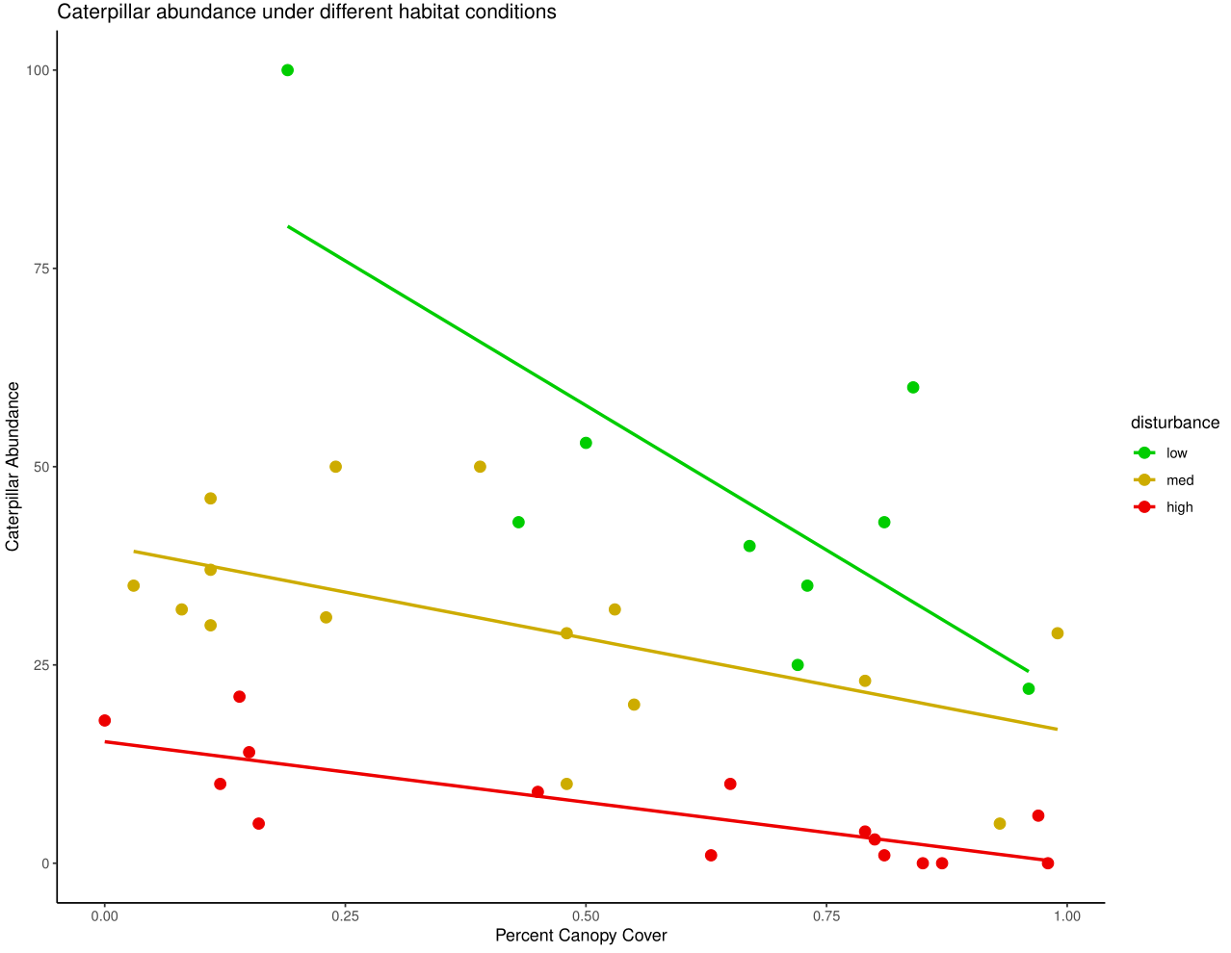
Do Exercise 5 in RStudio

Slide 37
Outline
Rstudio 101
Inputting & Organizing Data
Data Analysis & Graphing
Resources

Slide 38

Your best friend while working in R

Slide 39
Best websites
Quick-R
R documentation
Stackoverflow

Slide 40
When your code does not work:
Check your “code grammar” -> are your commas, parentheses, quotations all correct?
Is the package that contains this function loaded using library()?
If these are both correct, see if someone’s had the same problem and posted on stackoverflow

Slide 41
More resources
http://www.rpubs.com/collnellphd/rbasics
http://environmentalcomputing.net/
Ggplot cheat sheet:
https://www.rstudio.com/wp-content/uploads/2015/03/ggplot2-cheatsheet.pdf
Guide to scatter plots:
http://www.sthda.com/english/wiki/ggplot2-scatter-plots-quick-start-guide-r-software-and-data-visualization

Slide 42

Emily Kottler, ekottler@gwu.edu

